Slide 1
PROJECT DESCRIPTION: The Project “IMDB Movie Analysis” is about knowing, what factors could influence the success of a movie on the IMDB platform. The objective of this project is to help the makers of the film understand the significance of the film and the reasons for the success or failure of the film.
APPROACH: The approach is simple, just understand the data and remove the duplicates if any. Then, thoroughly read the description and hints provided to solve the queries. Also, this project is a bit lengthy so I divided the problems into pieces and solved them so that won’t be confusing.
TECH-STACK USED: I used Microsoft EXCEL 2021 Version which is inbuilt on my computer. The purpose of using EXCEL is because the task was demanding to use this software and it’s also easy in EXCEL compared to other software for descriptive analysis as it is a direct add-in function. Also, the data set provided was in an Excel sheet so it’s easy to proceed with it.
INSIGHTS: I understood how to calculate the profit margin for film and also got to know about variance and standard deviation in real-life examples. Understood descriptive statistics, histograms, and how to depict the relation between any two columns I Also, gained knowledge on how to convert a single column into multiple ones and apply filters too.
The key finding is that movies were released in mostly “English” other than English there were very few movies from other languages. Also, most movies were released in the “Drama” genre. There are no movies with more than 9 Average IMDB rating.

Slide 2
RESULT: I understand more clearly the statistics and their characteristics in real-world data. Like taking the correlation, and percentile to find out the range of input. I also got to know how to hyperlink the Excel sheet into the ppt and improved my communication skills by doing a 5-minute video on this project. The mindset of not only understanding the data and the queries but also understanding the patterns and domain knowledge contributed in a great way while doing this project.
LINK TO EXCEL SHEET(HyperLink)

Slide 3
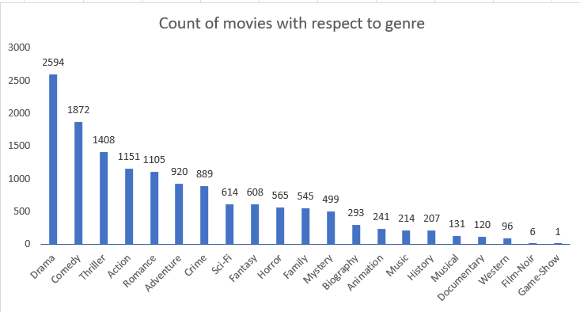
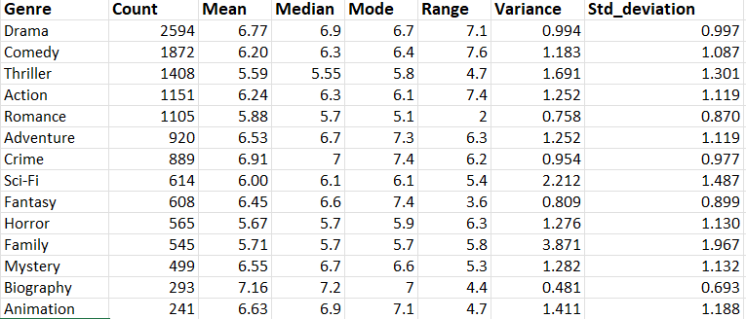
REPORT AND DATA STORY
Movie Genre Analysis:
i) The Above bar graph is drawn from the data shown beside. So the graphs depict the relation between the genre of the movies and their count.
ii) Movies related to “drama” have been released more compared to all the other genres. which means audiences are consuming more number of movies of drama.
iii) Then comes the “comedy” genre. Where 1872 movies were released, from the graph we can see the drastic change compared to drama. Then slowly the movies related to other genres are decreasing.
iv) Based upon the data, I can say that the audience should show interest in another genre as well if not then the other genre movies will go extinct and the filmmakers should also get out of their comfort zone and make movies of new types of genres.

Slide 4
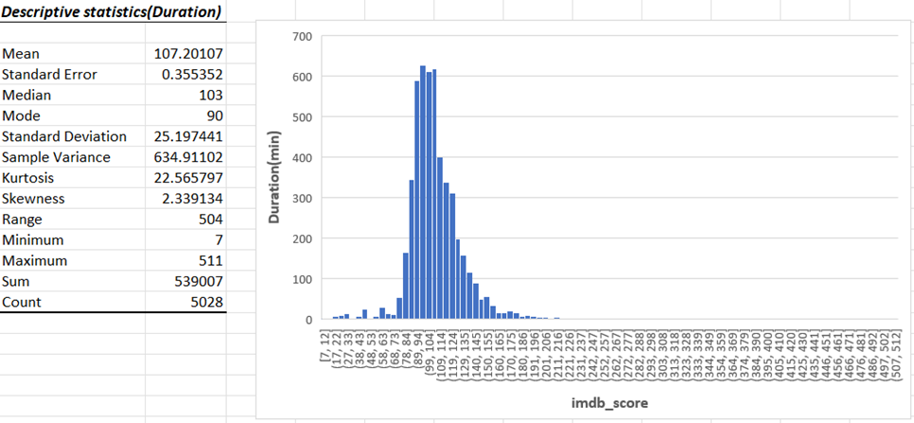
i) The data is about the movie duration in minutes. ii) The left side table is the descriptive statistics of the ‘duration column’. The first row states that the average movie duration is 107 minutes which is very surprising to me personally because I thought that could be much higher. iii) The movies with 90 min duration were more on the list which means the makers preferred to make short movies. iv) But contrast to the duration, IMDb scores are high for movies with longer duration.
Movie Duration Analysis:
v) So by the patterns and trends there is some misinterpretation between the choice of movie makers to make short movies and the IMDb scores scored by the movies.
vi) The IMDB scores also reveal that though there are audiences who prefer to watch short movies but majority of the people are willing to watch movies that last for a decent amount of time.

Slide 5
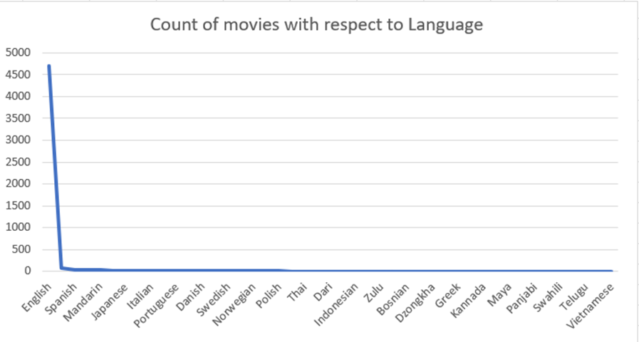
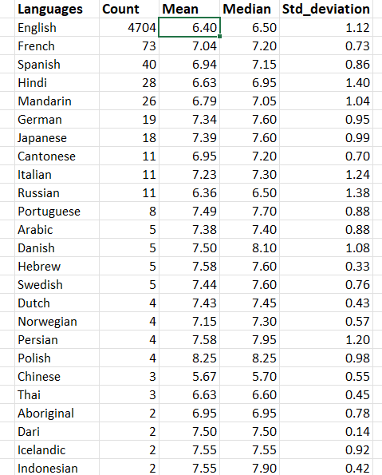
i) The data gives information about the count of movies released in different languages. ii) There is no surprise in looking at the graph because movies in the ‘English’ language have been released more than comes ‘French’ and ‘Spanish’. iii) The interesting stat is that the sum of the count of movies from all languages except English is still less than the count of movies released in the English language. iv) This is because ‘English’ is widely and commonly spoken all over the world. When it comes to IMDB scores ‘French’ movies have a really good score on average. Though the count of movies released in English are high the IMDB score is better.
Language Analysis:

Slide 6
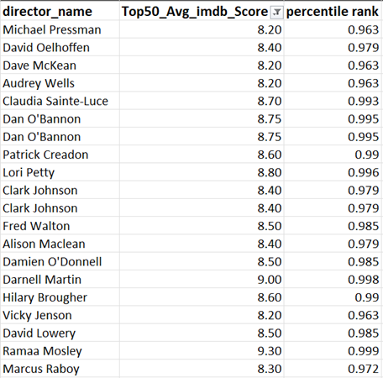
i) The table provides information about the directors who have the highest Average IMDB score among all the directors around the world. ii) The percentile is mentioned in the third column to compare the average IMDB score with the general score where the average is calculated irrespective of the director. iii) The percentile is basically about taking the highest average among the top 50 and marking it as 0.999 i.e., “Ramaa Mosley” with 9.3 avg_imdb_score and all the other rankings are given while compared to her average IMDB score. iv) The competition is very high between the directors when IMDB scores are concerned. Some directors are very famous and people-pleasing but they are not seen in this list because the average was not as high as their people. v) The count of movies released by the director might be high and that can also affect the average IMDB score.
Director Analysis

Slide 7
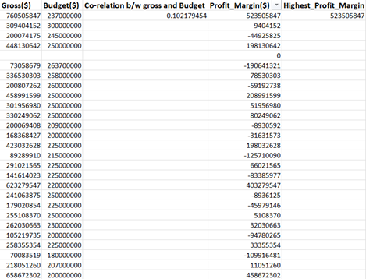
i) The Budget analysis means the amount of money invested in making a film and the gross amount gained from the film are compared and a figure that shows whether the movie has made a profit or loss. ii) There is an almost equal number of movies that are financially hits and flops. iii) The producers had to take risks while investing money into the film because there are equal perks to the losses. iv) The highest profit margin movie was directed by James Cameroon with a profit margin of 523M$. iv) The correlation between gross and budget was 0.1021. Correlation is a statistical measure that expresses the extent to which Gross and Budget variables are linearly related.
Budget Analysis

